Slide 1
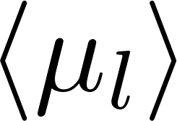
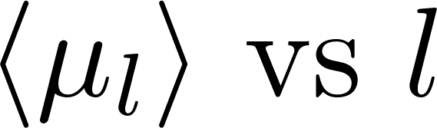
binned by 1 degree interval
Fit
Bayesian Statistics
likelihood function based on the data + Prior distribution
→ Posterior distribution of the parameters
Prior distribution
Likelihood function
Posterior distribution
Monte Carlo Simulation
Sampling from a high-dimension / complex probability distribution to
approximating the desired quantity
- sample from the set of parameters that produces the models that well-fit our data
Many walkers, initial guess around the maximum likelihood fit result
Markov Chain
Move little by little to find a better estimate of the parameter values.

Slide 2
Prior distribution
Likelihood function
Posterior distribution

Slide 3
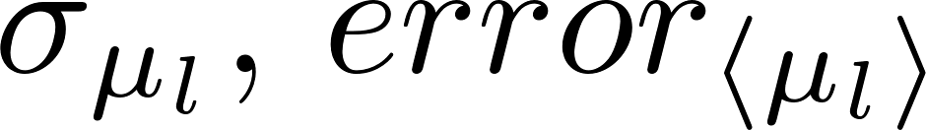
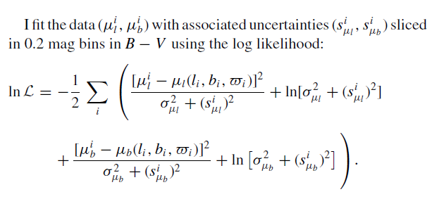
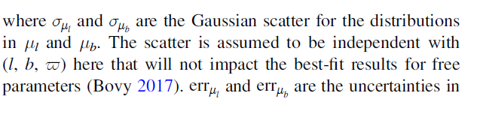
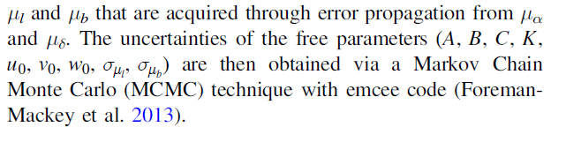
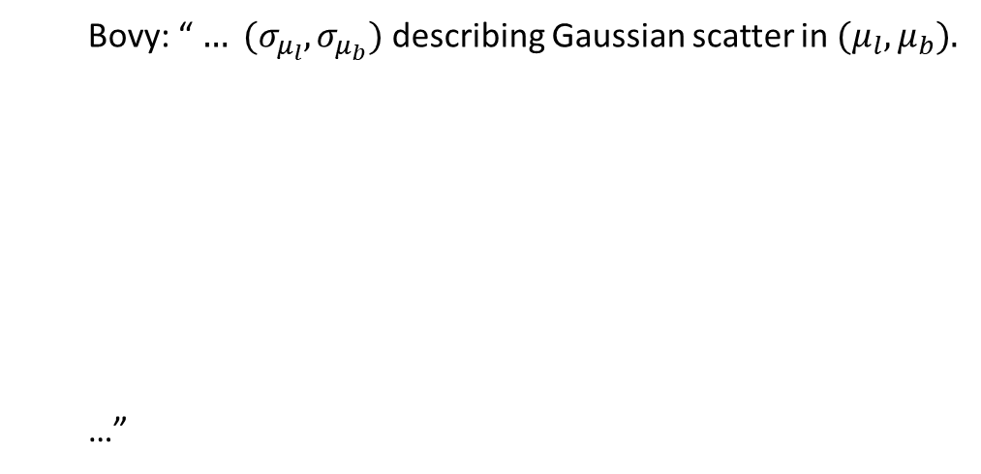

问题
以多少度为一个l bin合适
用什么
通过error propagation算出了每一个star的 $μ_{l}$ error, 但fit的是binned average，likelihood function里的error取binned error mean 吗？
Li: “ …
… “
Bovy: “ $… (σ_{μ_{l}},σ_{μ_{b}})$ describing Gaussian scatter in ${(μ}_{l},μ_{b}).$
…”

Slide 4
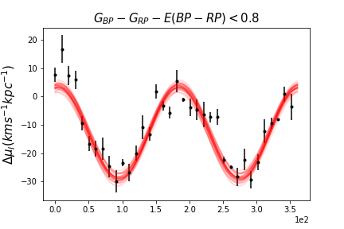
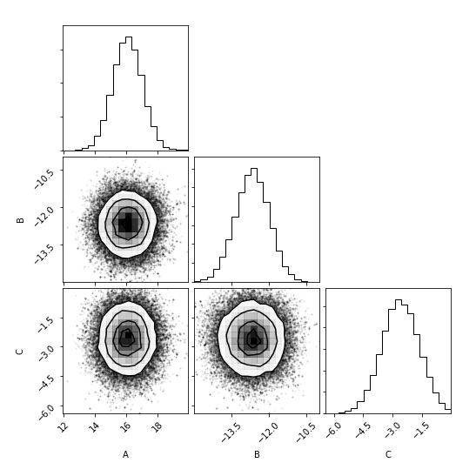
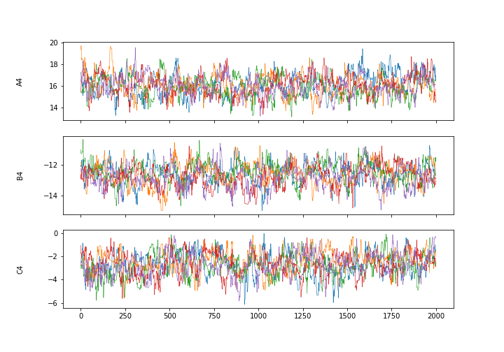
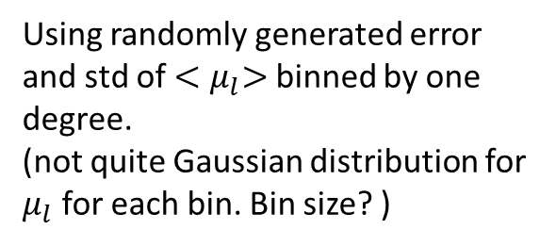
MCMC
Using randomly generated error and std of ${<μ}_{l}>$ binned by one degree.
(not quite Gaussian distribution for $μ_{l}$ for each bin. Bin size? )

